Slide 1



desafio_powerbi_data_analytics
View in Power BI
Last data refresh:
08/10/2024 14:10:48 UTC
Downloaded at:
08/10/2024 14:49:32 UTC

Slide 2

Home Page
Notes:
image
No alt text provided
image
No alt text provided
textbox
No alt text provided
shape
No alt text provided
textbox
No alt text provided
shape
No alt text provided
shape
No alt text provided

Slide 3
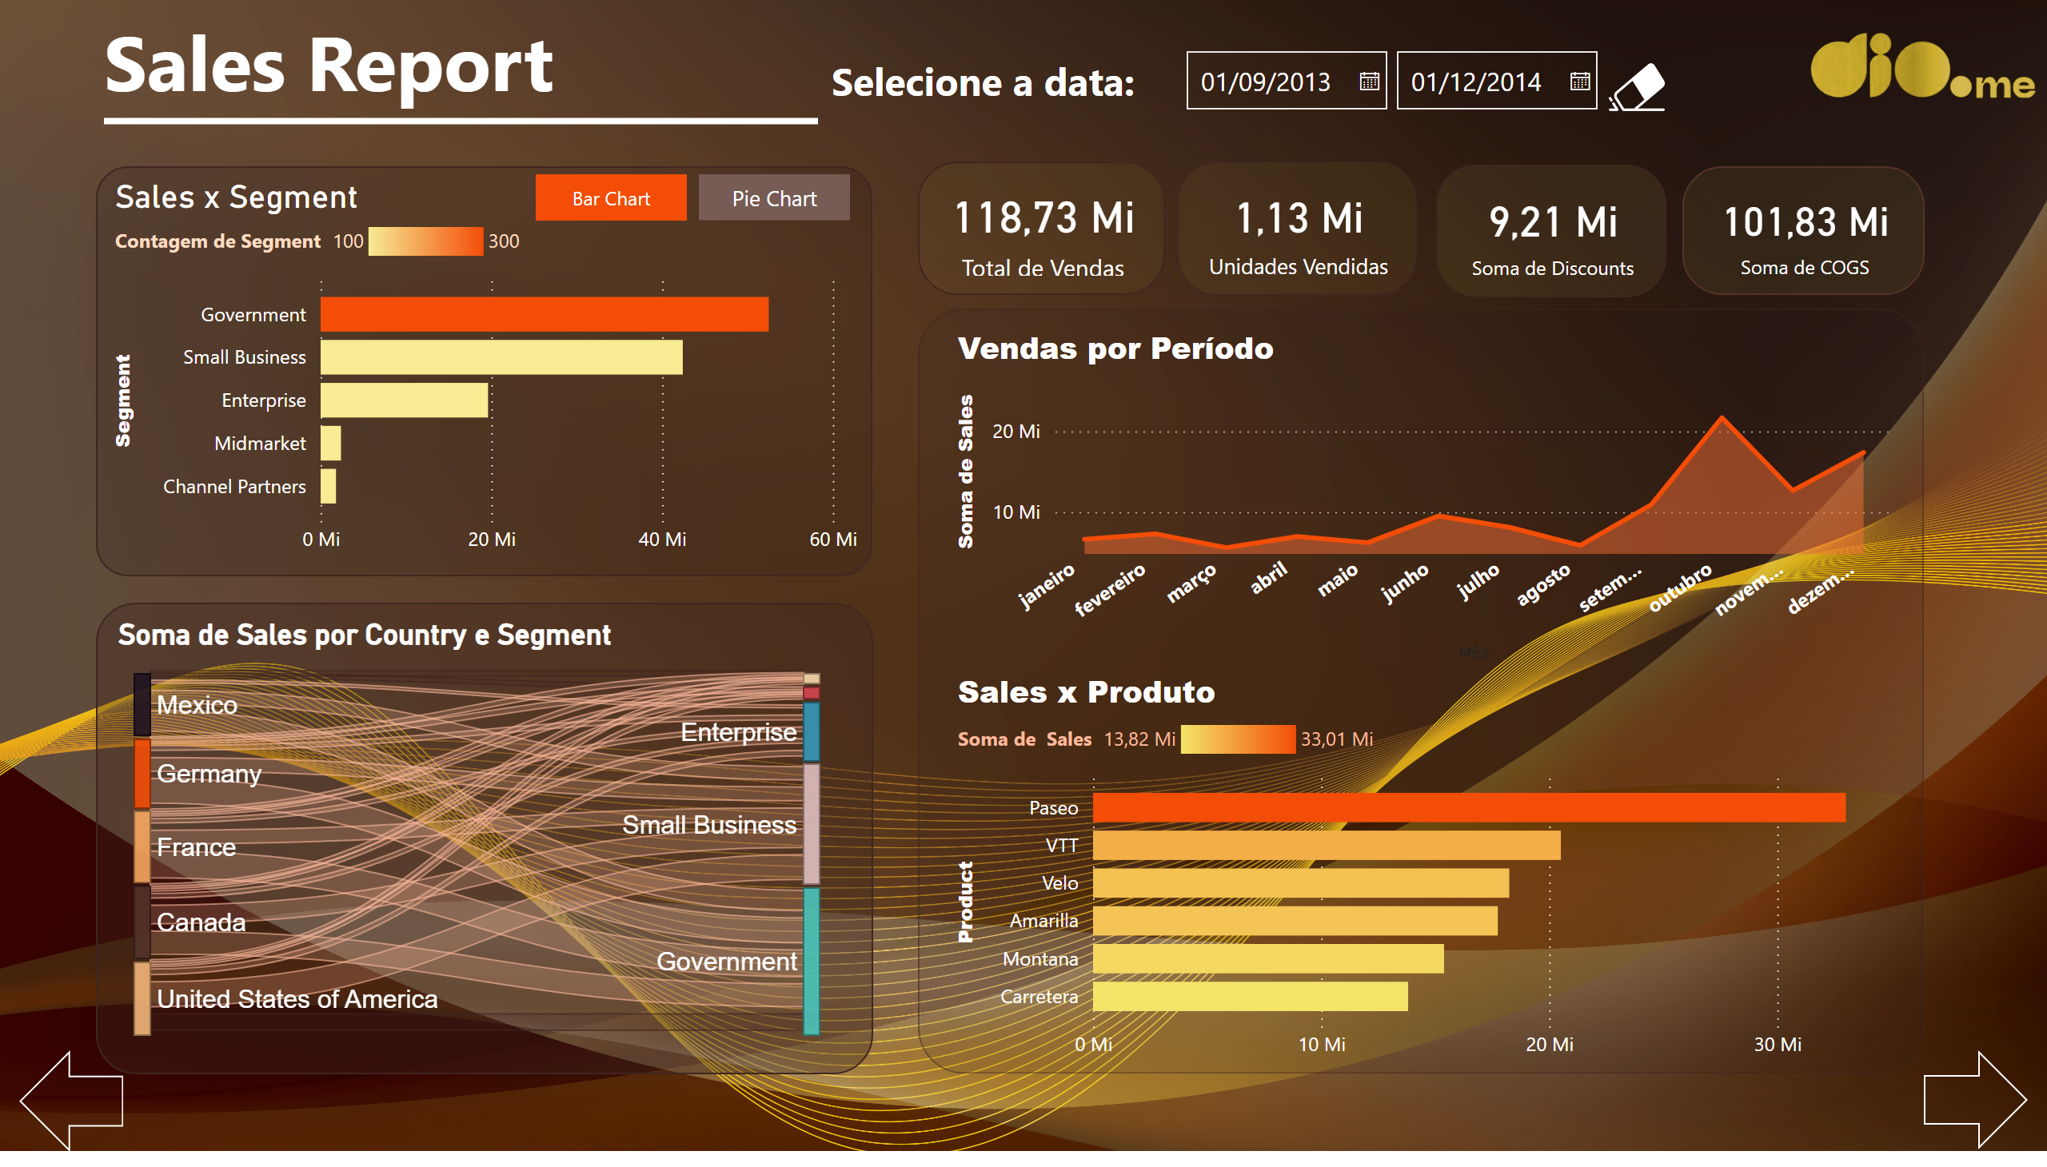
Sales Report
Notes:
card
No alt text provided
card
No alt text provided
card
No alt text provided
card
No alt text provided
textbox
No alt text provided
shape
No alt text provided
Botão - bar
No alt text provided
Botão -pie
No alt text provided
Sales x Segment
No alt text provided
donutChart
No alt text provided
Vendas por Período
No alt text provided
Sales x Produto
Este visual busca descrever a proporção de vendas por produtos através de um gráfico de barra clusterizado horizontal. O produto mais vendido corresponde ao Paseo. Em contrapartida o produto Carretera teve o pior desempenho.
actionButton
No alt text provided
textbox
No alt text provided
slicer
No alt text provided
image
No alt text provided
image
No alt text provided
shape
No alt text provided
shape
No alt text provided
shape
No alt text provided
sankey02300D1BE6F5427989F3DE31CCA9E0F32020
No alt text provided

Slide 4
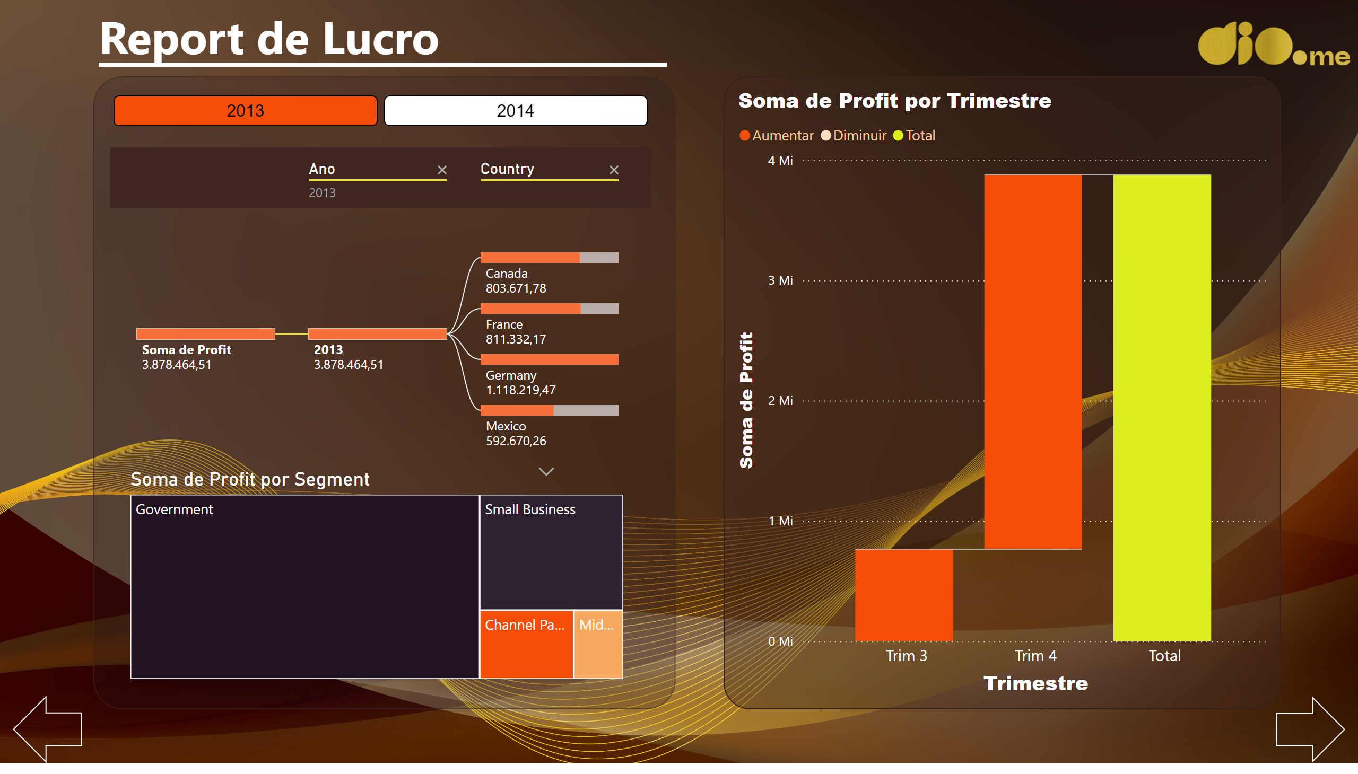
Profit Report
Notes:
shape
No alt text provided
decompositionTreeVisual
No alt text provided
waterfallChart
No alt text provided
ChicletSlicer1448559807354
No alt text provided
treemap
No alt text provided
textbox
No alt text provided
shape
No alt text provided
image
No alt text provided
shape
No alt text provided
shape
No alt text provided
shape
No alt text provided

Slide 5
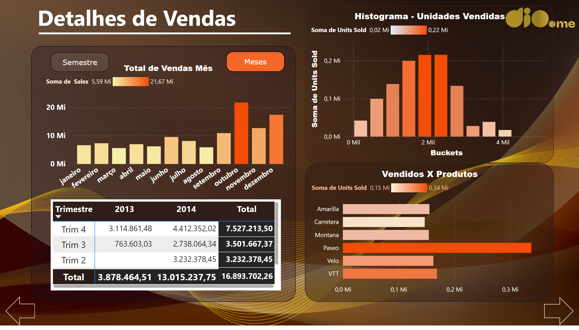
Details of Sales
Notes:
shape
No alt text provided
pivotTable
No alt text provided
textbox
No alt text provided
shape
No alt text provided
shape
No alt text provided
Total de Vendas Mês
No alt text provided
clusteredColumnChart
No alt text provided
Meses Ativo
No alt text provided
shape
No alt text provided
Meses Inativo
No alt text provided
Semestres Inativo
No alt text provided
shape
No alt text provided
Vendidos X Produtos
No alt text provided
image
No alt text provided
shape
No alt text provided
Histograma - Unidades Vendidas
No alt text provided

Slide 6
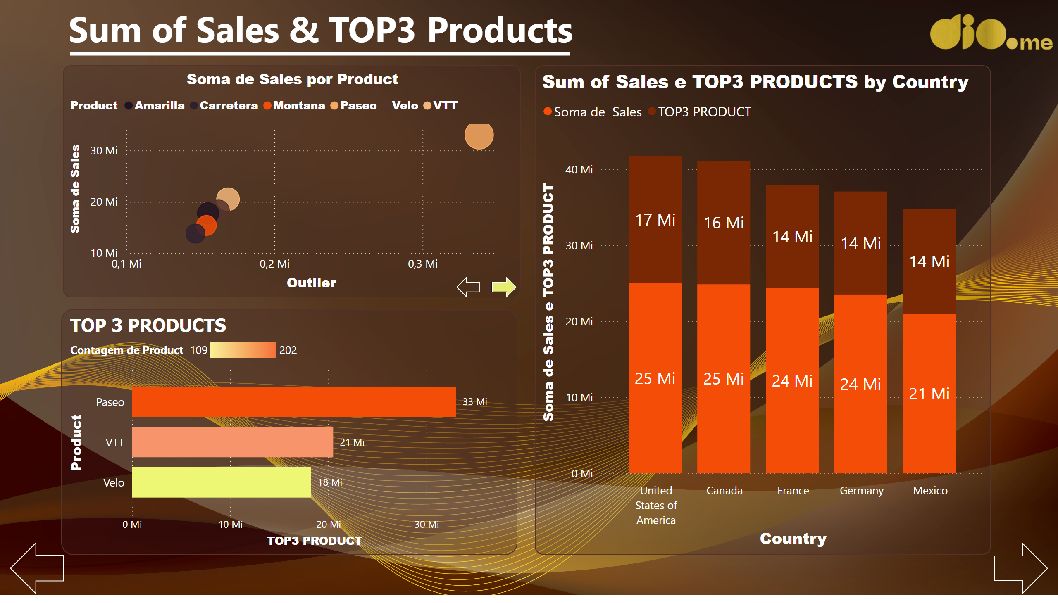
Sum of Sales & TOP 3 Products
Notes:
TOP 3 PRODUCTS
No alt text provided
Sum of Sales e TOP3 PRODUCTS by Country
No alt text provided
scatterChart
No alt text provided
Soma de Sales por Product
No alt text provided
image
No alt text provided
Seta esq
No alt text provided
Seta dir
No alt text provided
Dir ativa
No alt text provided
shape
No alt text provided
Dir inativa
No alt text provided
Esq inativa
No alt text provided
textbox
No alt text provided
shape
No alt text provided

Slide 7
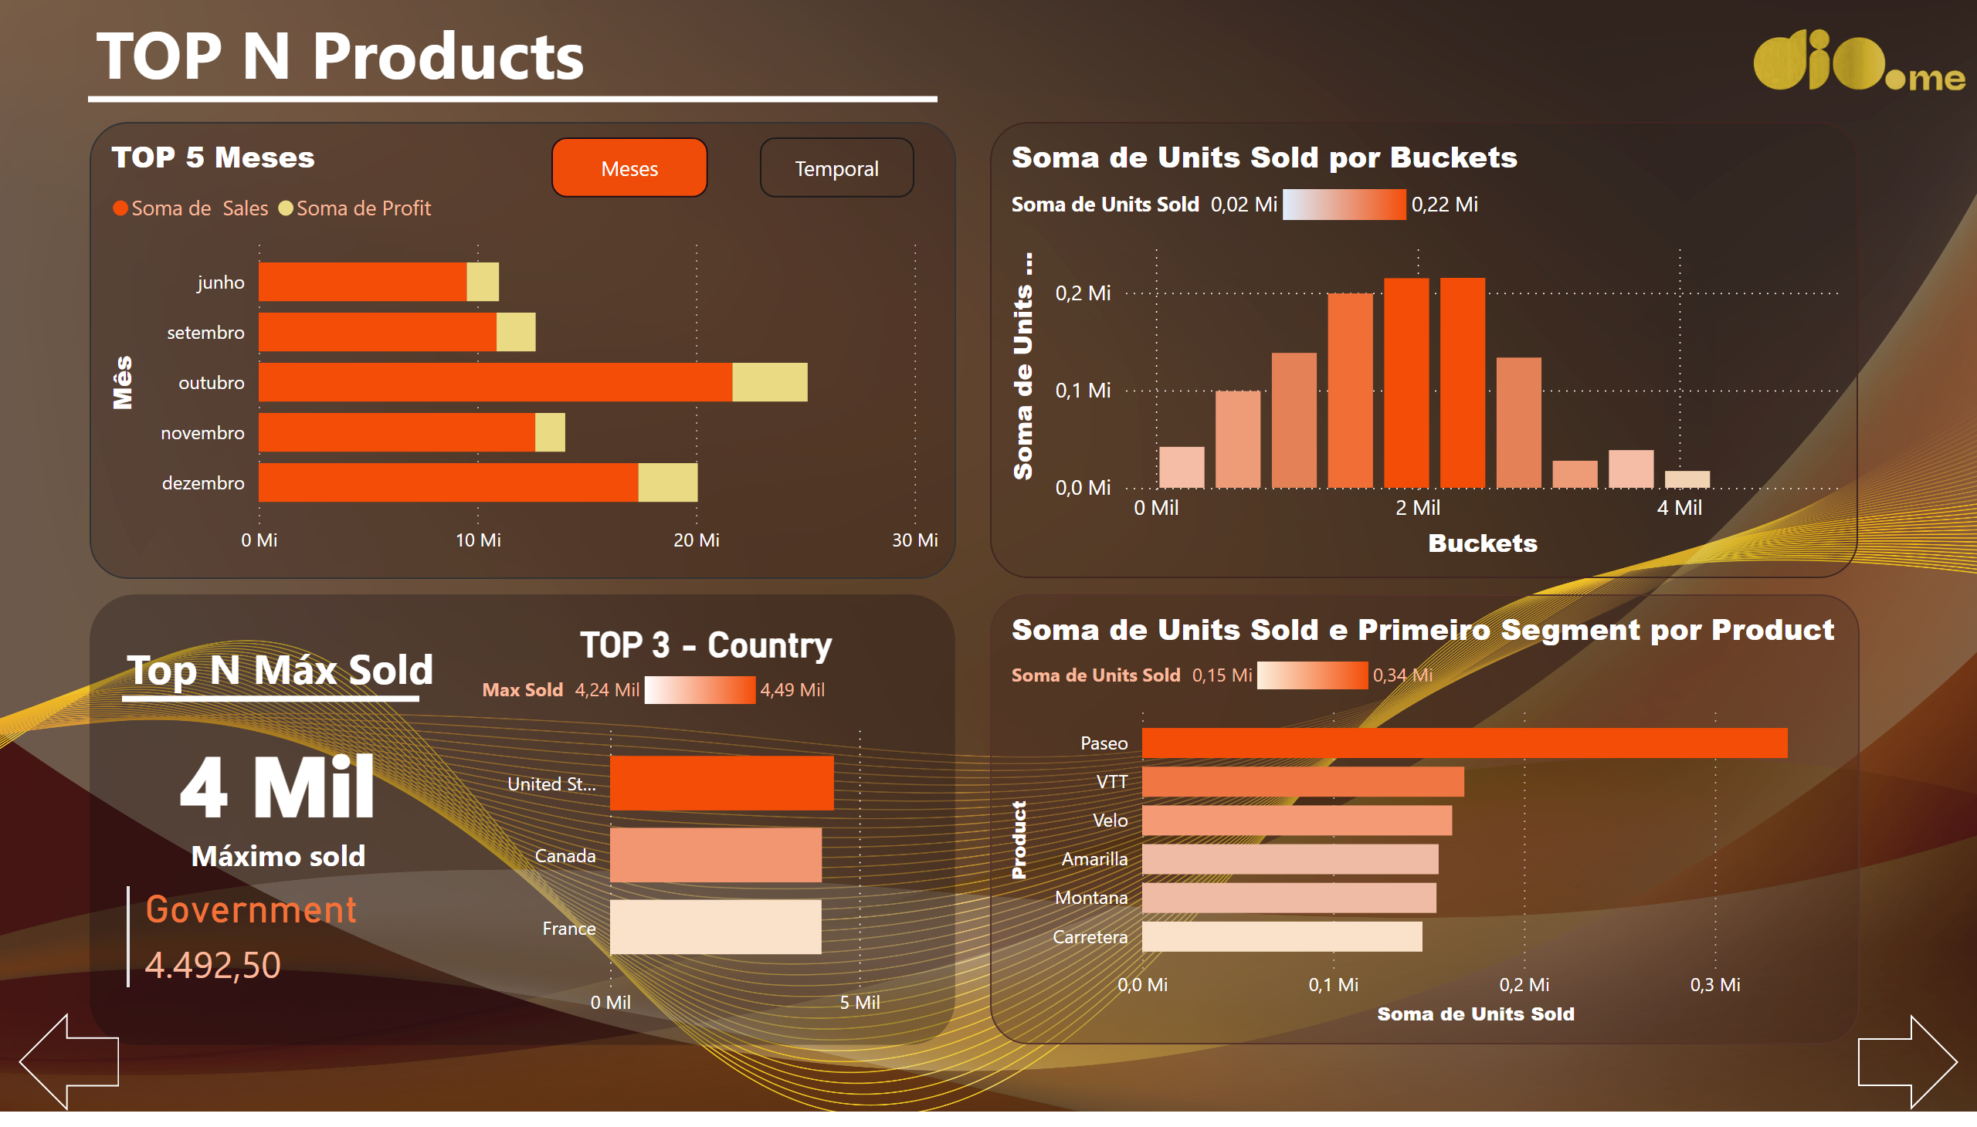
TOP-N Products
Notes:
clusteredBarChart
No alt text provided
clusteredColumnChart
No alt text provided
TOP 3 - Country
No alt text provided
shape
No alt text provided
card
No alt text provided
multiRowCard
No alt text provided
textbox
No alt text provided
shape
No alt text provided
areaChart
No alt text provided
TOP 5 Meses
No alt text provided
image
No alt text provided
Seta esq
No alt text provided
Seta dir
No alt text provided
Meses inativo
No alt text provided
Meses ativo
No alt text provided
Temporal inativo
No alt text provided
actionButton
No alt text provided
textbox
No alt text provided
shape
No alt text provided

Slide 8
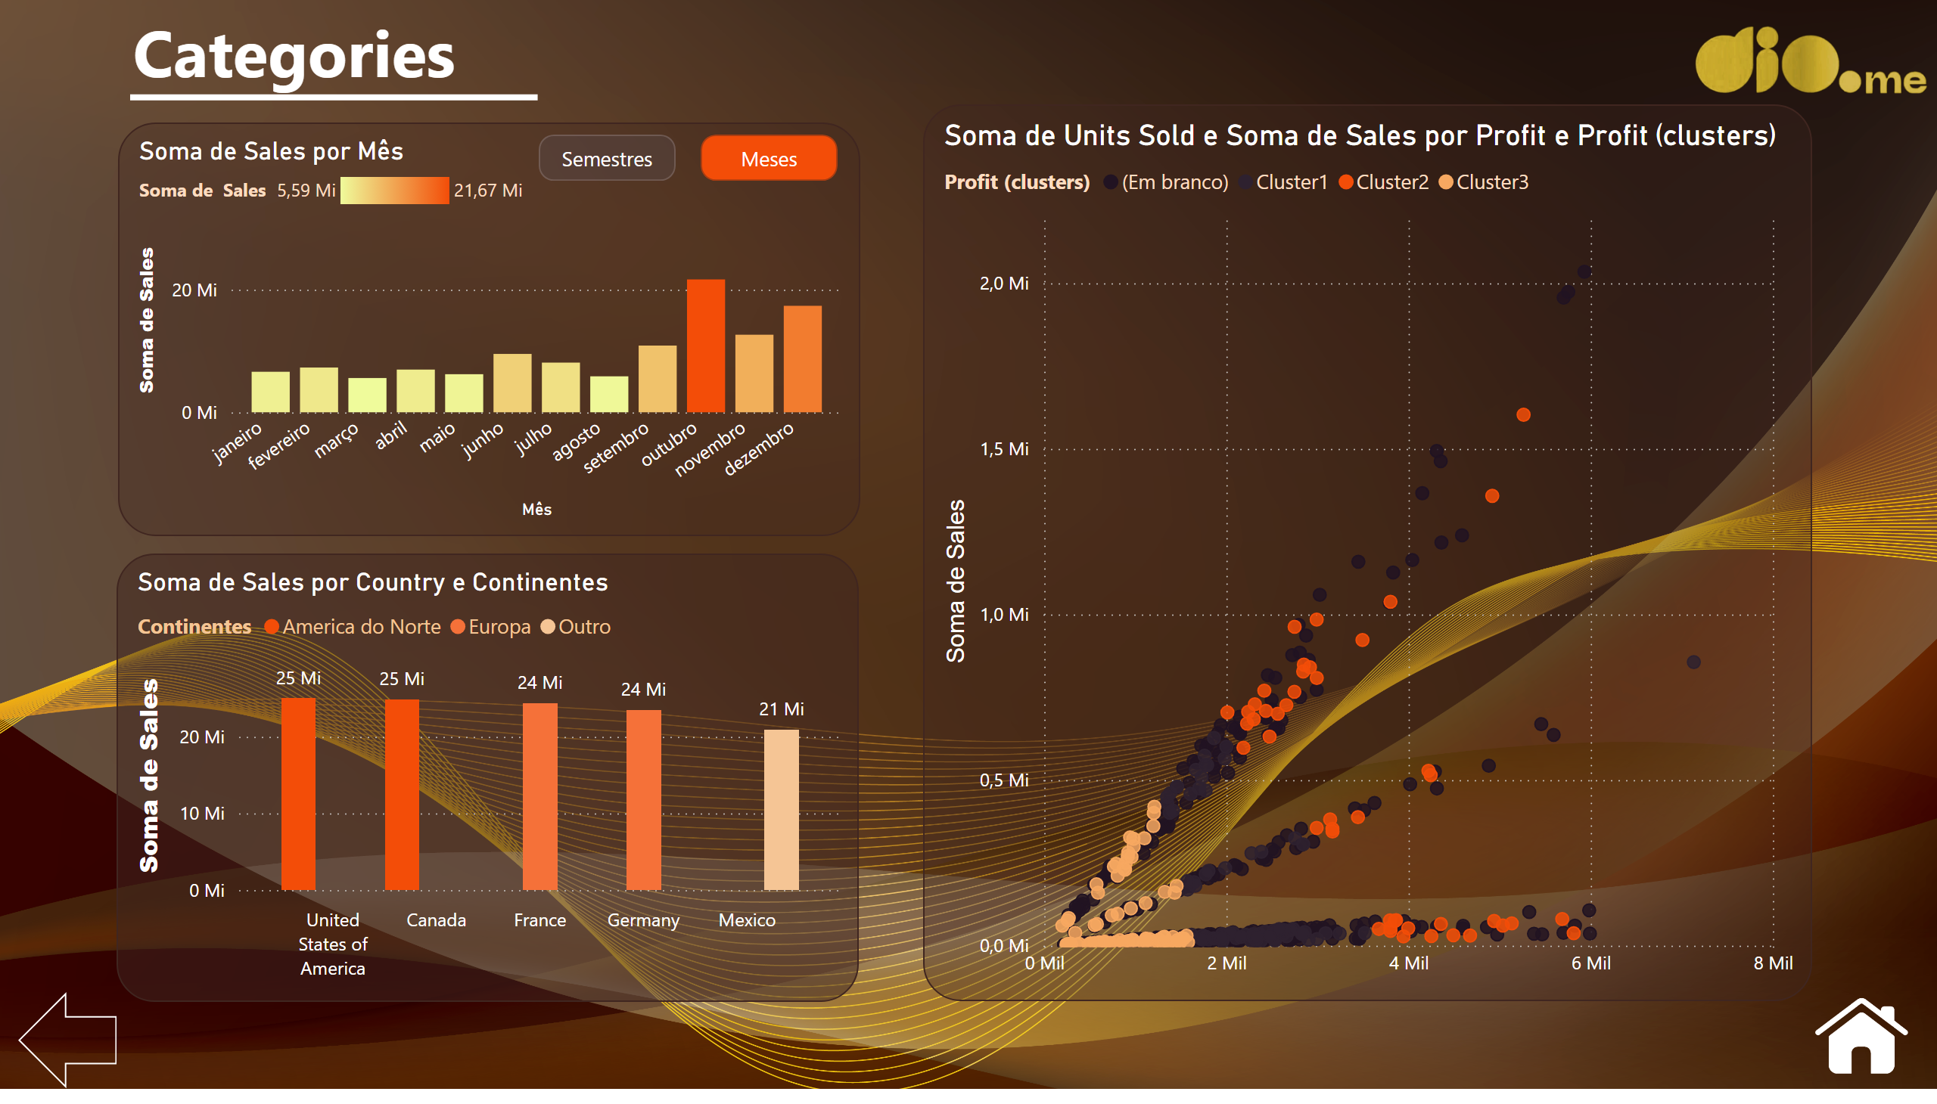
Categories
Notes:
clusteredColumnChart
No alt text provided
clusteredColumnChart
No alt text provided
clusteredColumnChart
No alt text provided
clusteredColumnChart
No alt text provided
scatterChart
No alt text provided
image
No alt text provided
Seta esq
No alt text provided
textbox
No alt text provided
shape
No alt text provided
Semestres inativo
No alt text provided
actionButton
No alt text provided
actionButton
No alt text provided
Meses ativo
No alt text provided
image
No alt text provided

